Slide 1
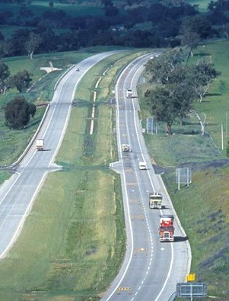
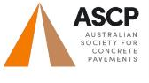

Structural Concrete Highway Shoulders
  Forty Years of Successful Experience
  in Asset Management
John Hodgkinson AM RFD BE
Honorary Member
22ND OCTOBER – 24TH OCTOBER 2023
7TH CONCRETE PAVEMENT CONFERENCE

Slide 2
How long is 40 Years?
2023 marks 40 years since the start of multi-lane slipform paving and high output site production plants in Australia
40 years just happens to be a typical 'design life' for highway pavements
structural concrete shoulders have been an integral element over this period
this paper presents a successful design life of experience in asset management incorporating concrete shoulders in highways and similar classification roads.
ASCP 7TH CONCRETE PAVEMENT CONFERENCE

Slide 3
Asset Management
Definition used in this paper
In the context of a highway, motorway and similar classification roads incorporating a concrete shoulder, the definition adopted in this paper is
“a systematic process of developing, operating and maintaining long term assets in the most cost-effective manner”.
ASCP 7TH CONCRETE PAVEMENT CONFERENCE

Slide 4
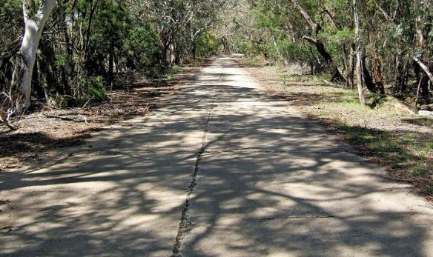
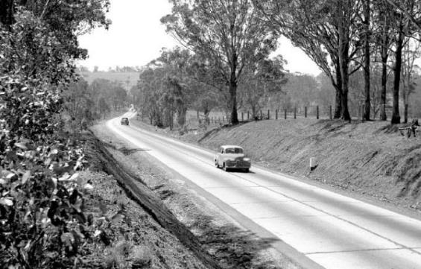
Early concrete highways – no shoulders
“Old” Hume Highway
200km south west from Sydney 1927
“Old” Hume Highway
60km south west from Sydney 1950(?)
ASCP 7TH CONCRETE PAVEMENT CONFERENCE

Slide 5
In the 1920s the Westergaard equations showed wheel stresses at an edge were about 30% greater than within a slab
In the absence of a structural shoulder, edge thickening was a common detail until the 1950s
NSW DMR drawing detail (paper ref 2)
ASCP 7TH CONCRETE PAVEMENT CONFERENCE

Slide 6
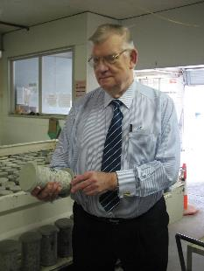
First use of structural concrete shoulders
Warringah Freeway Sydney 1965-67
(late) Arvo Tinni AM
Honorary Member ASCP
Supervising Engineer
ASCP 7TH CONCRETE PAVEMENT CONFERENCE

Slide 7
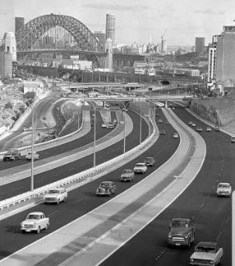
Three-lane carriageway
Concrete shoulders
2.45 – 3.0m wide
Asphalt used for riding quality, no other purpose.
Project preceded slipform paving by 12-13 years
ASCP 7TH CONCRETE PAVEMENT CONFERENCE

Slide 8
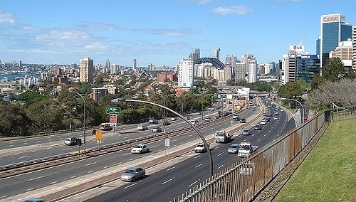
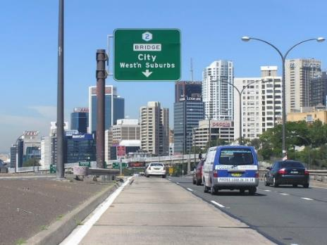
Concrete shoulders later/now used as trafficked lanes (AADT > 200,000)
ASCP 7TH CONCRETE PAVEMENT CONFERENCE

Slide 9
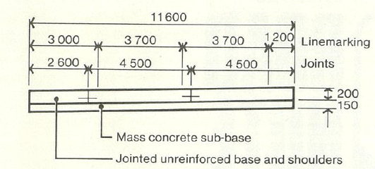
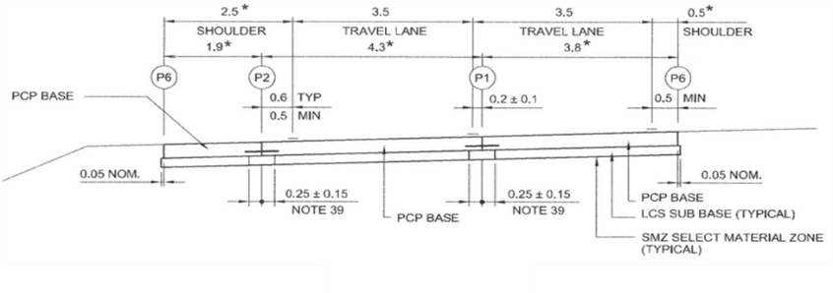
Structural concrete shoulders have been standard for 40 years since 1983
Evolution in carriageway details
1980s
Lane 3.7m, shoulder 3.0m
Current drawing
Lane 3.5m, shoulder 2.5m
(paper ref 13)
ASCP 7TH CONCRETE PAVEMENT CONFERENCE

Slide 10
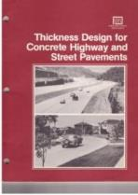
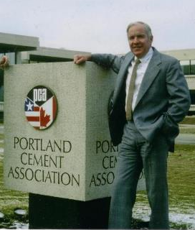
PCA 84 : Thickness Design
Successor to PCA 1966 used by NAASRA until 1988
Adopted by Austroads in 1992 and since
PCA 1984 allows design for shoulder or no shoulder
More on thickness later
But did not define “shoulder”
Many conversations with Bob Packard 1984 to 1989
But what constitutes a structural shoulder?
ASCP 7TH CONCRETE PAVEMENT CONFERENCE

Slide 11

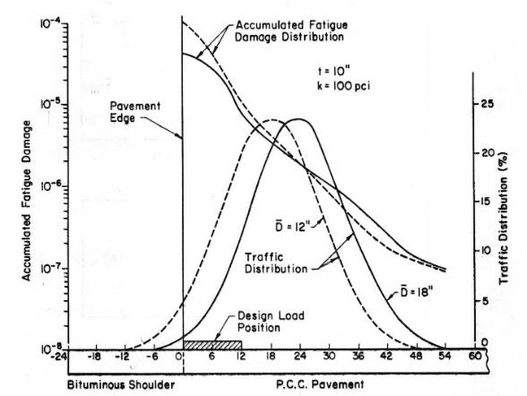

What constitutes structural concrete shoulder ?
Purdue University Conference 1989 (Paper Ref 11)
(late) Ernie Barenberg
Dan Zollinger
ASCP 7TH CONCRETE PAVEMENT CONFERENCE

Slide 12
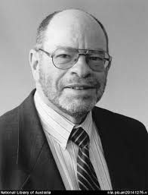
Australian “good old fashioned” engineering judgement
(late) Ed Haber, DMR/RTA legend
ASCP 7TH CONCRETE PAVEMENT CONFERENCE

Slide 13


Structural shoulder criteria
Nominal edge of pavement
(a) Integral widening min 600mm
(b) Min 1.5m tied width
(c) Integral kerb min 600mm width
ASCP 7TH CONCRETE PAVEMENT CONFERENCE

Slide 14
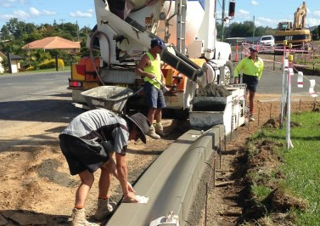
Structural shoulder criteria
Must have the same thickness and concrete quality as for trafficked lanes
Must be fully supported by subbase
Municipal type ‘kerbmaker’ extruded concrete kerb does not qualify
ASCP 7TH CONCRETE PAVEMENT CONFERENCE

Slide 15
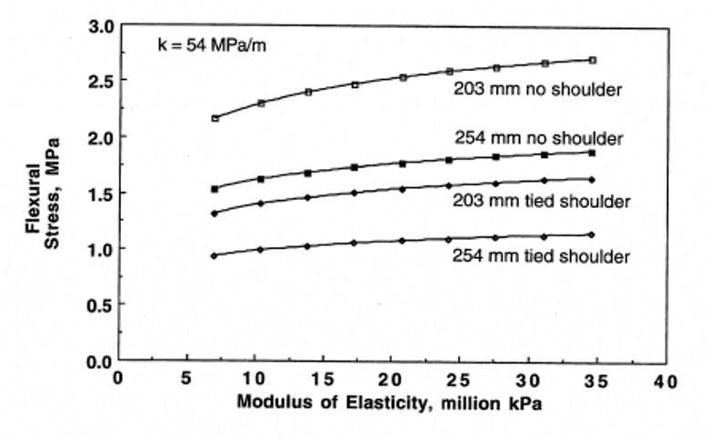
Reduction in flexural stress – shoulder or no shoulder
Okamoto et al Purdue 1993 (Paper Ref 12)
200mm : No shoulder 2.5MPa – shoulder 1.5MPa – reduction 40%
250mm : No shoulder 1.75 MPa – shoulder 1.0MPa - reduction 40%
Based on CBR of ~8% under the slab
(*) Modulus 30 MPa close to 35MPa compressive strength
(cylinders)
(*)
ASCP 7TH CONCRETE PAVEMENT CONFERENCE
Notes:
The above stresses by ‘approximate inspection’ from the Figure are close enough to illustrate the significant structural benefit of a concrete shoulder

Slide 16

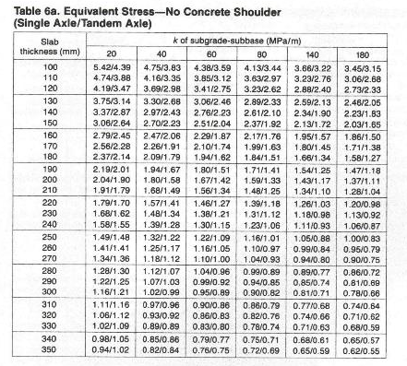
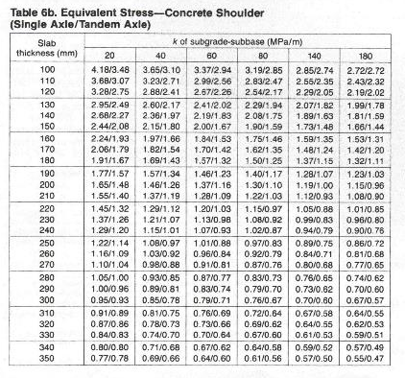
PCA : Reduction in ‘Equivalent Stress’ – Table 6 (paper ref 10)
No shoulder - Shoulder
Typical support/base thicknesses
Reduction in equivalent stress in range 20-25%
ASCP 7TH CONCRETE PAVEMENT CONFERENCE

Slide 17
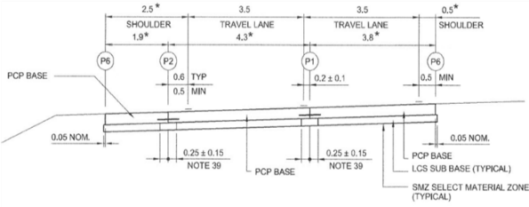
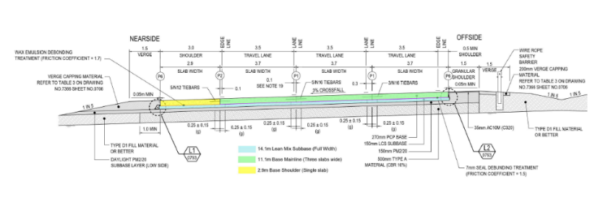
Contemporary carriageway cross sections with concrete shoulders
NSW 2-lane carriageway (paper ref 13)
Adelaide
Northern Connector
3-lane carriageway
(courtesy Jamie Egan)
ASCP 7TH CONCRETE PAVEMENT CONFERENCE

Slide 18
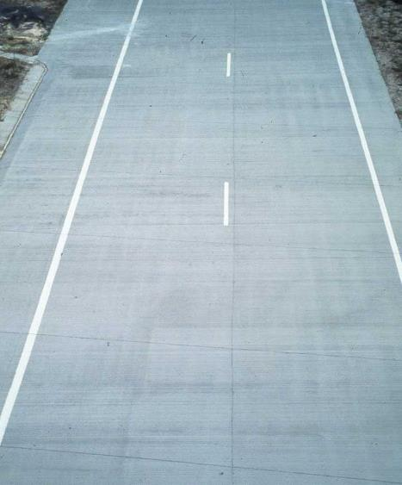
NSW 2 –Lane carriageway
Concrete shoulder adjacent slow lane
Concrete ‘berm’ adjacent median
Widened truck lane
ASCP 7TH CONCRETE PAVEMENT CONFERENCE

Slide 19
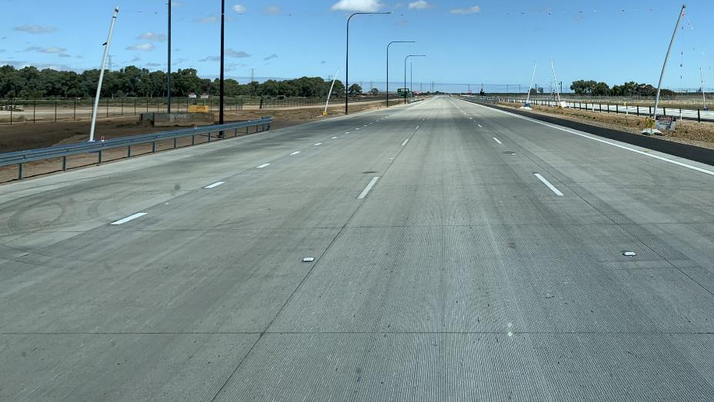
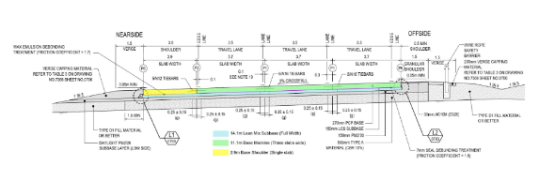
Northern Connector Adelaide Carriageway
(3 x lanes with concrete shoulder)
ASCP 7TH CONCRETE PAVEMENT CONFERENCE

Slide 20
Widened truck lane detail – introduced same time as concrete shoulders (paper ref 13)
Additional benefit for edge stresses
Not technically difficult or costly to build
ASCP 7TH CONCRETE PAVEMENT CONFERENCE

Slide 21
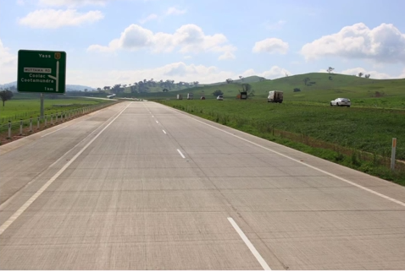
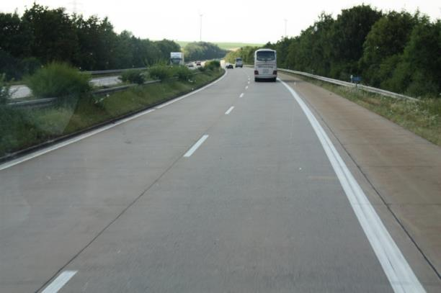
Concrete shoulder and widened truck lane
Examples of applications
A31 Southern NSW German Autobahn A7 E45 E43
Würzburg to Rothenberg
ASCP 7TH CONCRETE PAVEMENT CONFERENCE

Slide 22
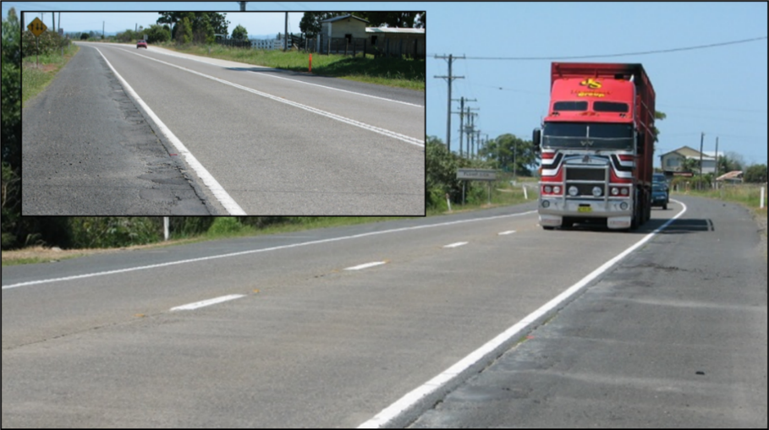
Concrete provides continuity of pavement type/thickness across carriageway
Issues/problems with shoulder drainage and maintenance – lanes unaffected
Different materials (paper ref 16)
ASCP 7TH CONCRETE PAVEMENT CONFERENCE

Slide 23
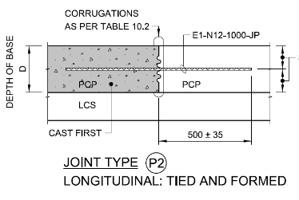
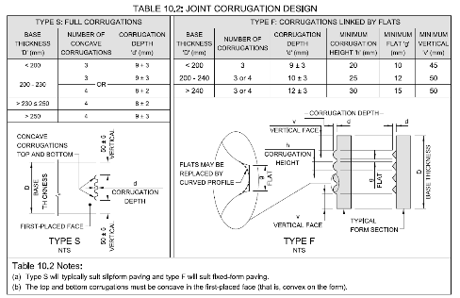
Lane/shoulder longitudinal construction joint (paper ref 13)
(corrugations introduced by G Ayton)
ASCP 7TH CONCRETE PAVEMENT CONFERENCE

Slide 24
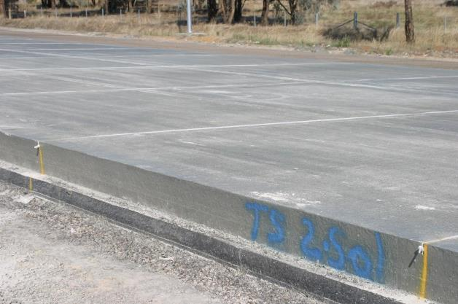
Widening of subbase to provide full support to shoulder/base
Completed carriageway
ASCP 7TH CONCRETE PAVEMENT CONFERENCE

Slide 25

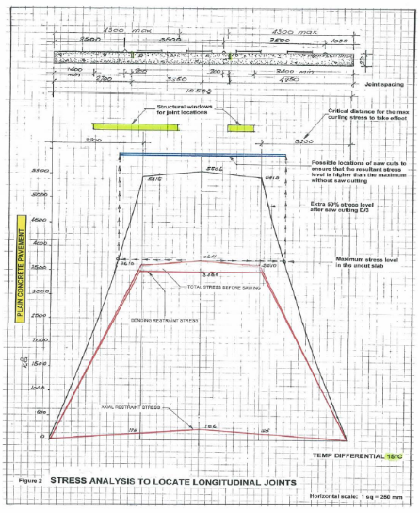
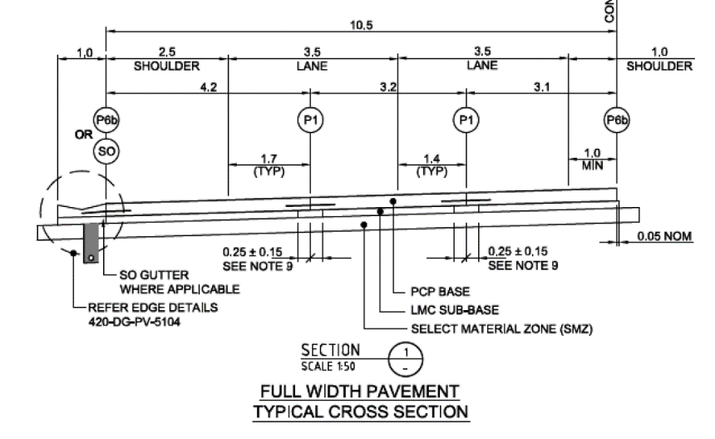
Australian Innovation – 2011/2013
Stress analysis across carriageway – locations of longitudinal joint (paper ref 17)
Full width paving
Arvo Tinni
(Okamoto)
Shoulder integrated into pavement
ASCP 7TH CONCRETE PAVEMENT CONFERENCE

Slide 26
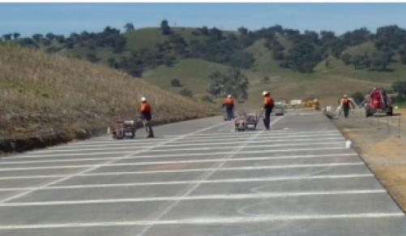
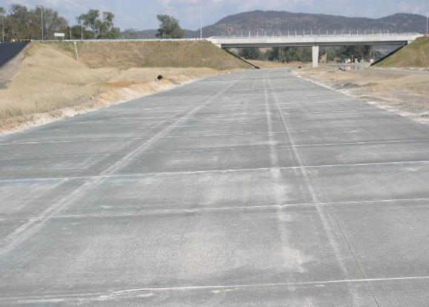
Longitudinal joints – full width paving - 2013
Simultaneous transverse and longitudinal joint sawing in progress
Completed carriageway. (linemarking ‘drawn’)
Structural shoulder integrated with pavement
ASCP 7TH CONCRETE PAVEMENT CONFERENCE

Slide 27

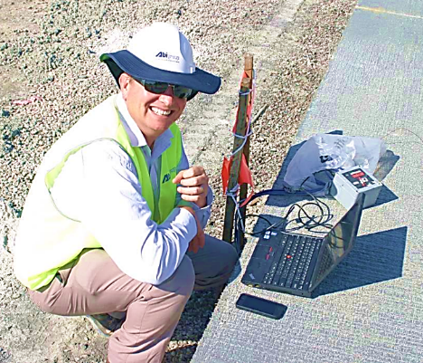

Photography down into longitudinal sawcuts (paper ref 19)
ASCP 7TH CONCRETE PAVEMENT CONFERENCE

Slide 28
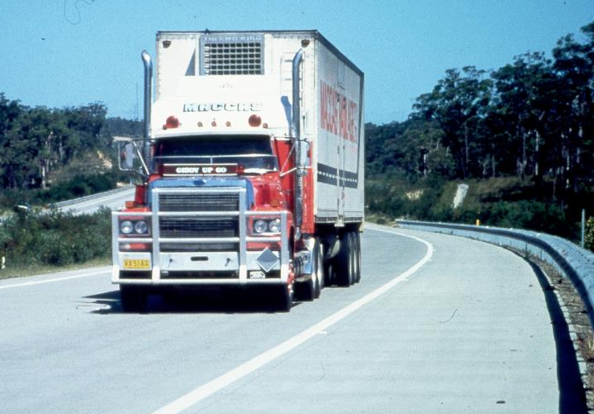
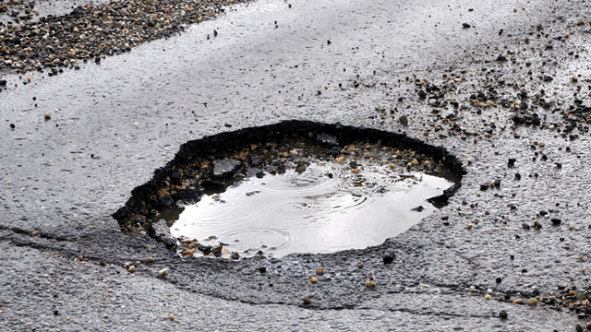
Maintenance – not an issue with a concrete shoulder
When do you see a pothole or patch repair in a concrete shoulder
independent of any lane patching/replacement ?
ASCP 7TH CONCRETE PAVEMENT CONFERENCE

Slide 29
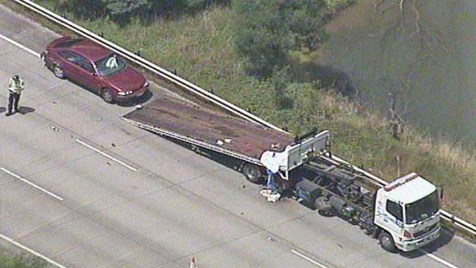
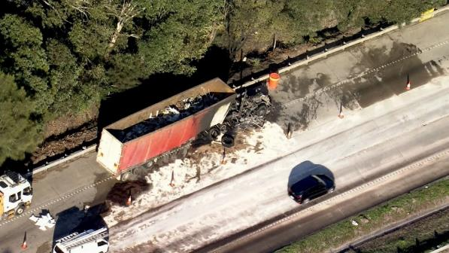
Important safety criterion
Shoulder as emergency/breakdown lane
Irrespective of material used, width should be able to fully accommodate vehicles
Structurally OK but are width current standards always adequate?
Examples of incidents/situations
ASCP 7TH CONCRETE PAVEMENT CONFERENCE

Slide 30
Comparative concrete base thickness/volume
No shoulder
?
Thickness + (~) 8-9%
Volume + (~) 2%
Concrete shoulder
ASCP 7TH CONCRETE PAVEMENT CONFERENCE

Slide 31
Engineering and Economic Judgement
The marginal increase in concrete volume for the concrete shoulder is effectively discounted by the benefit of not having to patch potholes or the need for resurfacing materials for a very long time
This is not gold plating but sound long term engineering and economic judgement for long term public asset management for long design lives
Based on more than 50 years experience with concrete pavements, the author would not support any relaxation of thickness/shoulder standards with a view to simply reducing construction costs or appeasing short term political interests if agencies are serious about achieving design lives of 40 years or more without very substantial rehabilitation
ASCP 7TH CONCRETE PAVEMENT CONFERENCE

Slide 32
Summarised Conclusions (a)
The criteria and detailing of structural concrete shoulders are established.
Concrete shoulders allow a reduction in base thickness with a marginal increase in concrete requirements.
Two construction options are available,
(a) Construct travelling lanes and add the shoulder with a tied construction joint
(b) Construct the carriageway full width with innovative longitudinal joint locations
Maintenance or patching of the concrete pavement in a shoulder has been negligible
ASCP 7TH CONCRETE PAVEMENT CONFERENCE

Slide 33
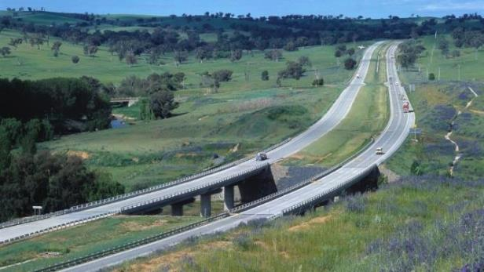
Summarised Conclusions (b)
Key message from this paper :
As an important element of asset management, structural concrete shoulders have been one of the best and proven engineering and economic investments in highway construction over a forty-year period contributing to long design lives in long term public assets
ASCP 7TH CONCRETE PAVEMENT CONFERENCE

Slide 34
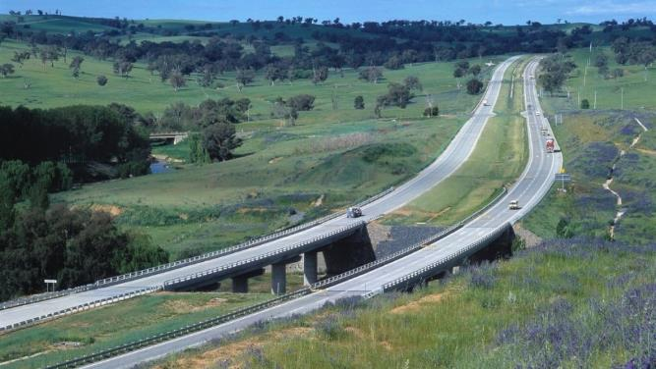
Questions ?
ASCP 7TH CONCRETE PAVEMENT CONFERENCE

Slide 35
ASCP 7TH CONCRETE PAVEMENT CONFERENCE

